Slide 1


Diabetic Retinopathy
Team members
K.Rahul kumar
Haider ali
Sai Rama Krishna
Venkat korada

Slide 2
Diabetic retinopathy:
Diabetic retinopathy is a diabetes complication that affects eyes.
It may cause no symptoms or only mild vision problems.
You might not have symptoms in the early stages of diabetic retinopathy. As the condition progresses, diabetic retinopathy .
symptoms may include:
Spots or dark strings floating in your vision (floaters)
Blurred vision
Fluctuating vision
Impaired color vision
Dark or empty areas in your vision
Vision loss
Diabetic retinopathy usually affects both eyes.

Slide 3
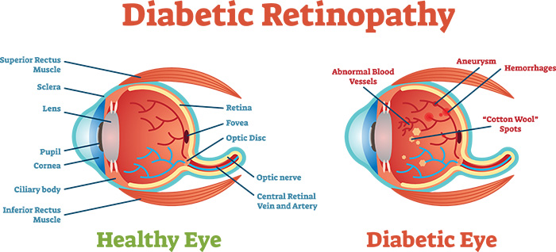

Slide 4
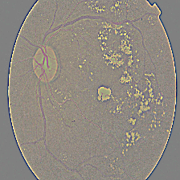
About Data set
The original data set is about 80gb of high resolution images but we have used its resized version which are about 433mb total
this images consist of gaussian filtered retina scan images to detect diabetic retinopathy
These images are resized into 224*224 pixel so they can be used directly in pre-trained model .
Also contains an export.pk1 file which is trained dataset using fastAI library
You find 5 directories with respective images:
0-NO_DR
1- MILD
2-MODERATE
3-SEVERE
4-PROLIFERATE

Slide 5
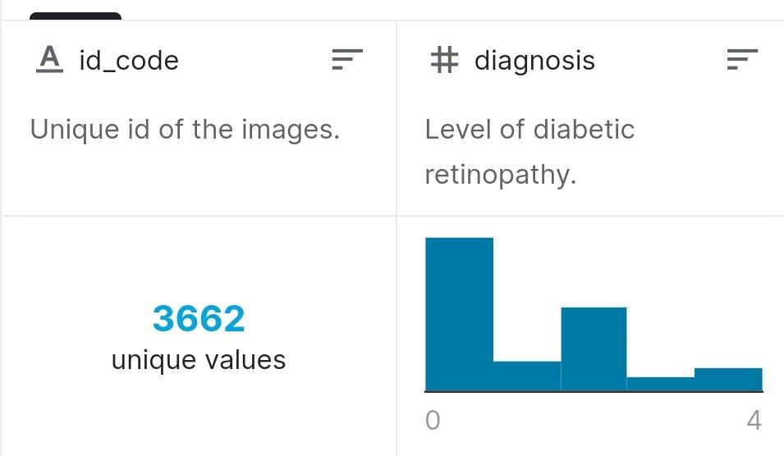
train.csv
It contains the level of diabetic retinopathy ranging from 0 to 4 with the id values corresponding to the images in the gaussian_filterd_images directory
The pictures shows the columns of file. There are 3662 unique values and the above is the bar diagram shows the distribution of data.

Slide 6
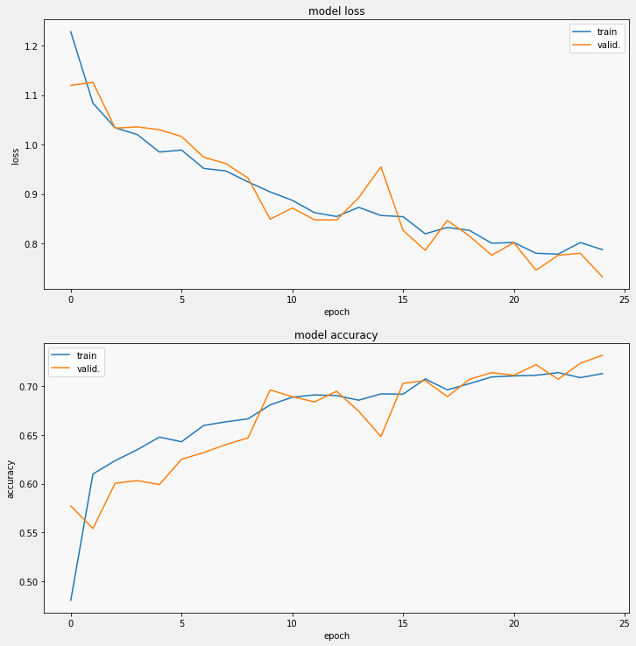
First we used normal CNN model with “softmax” activation function. Which gave the accuracy of around 70%

Slide 7
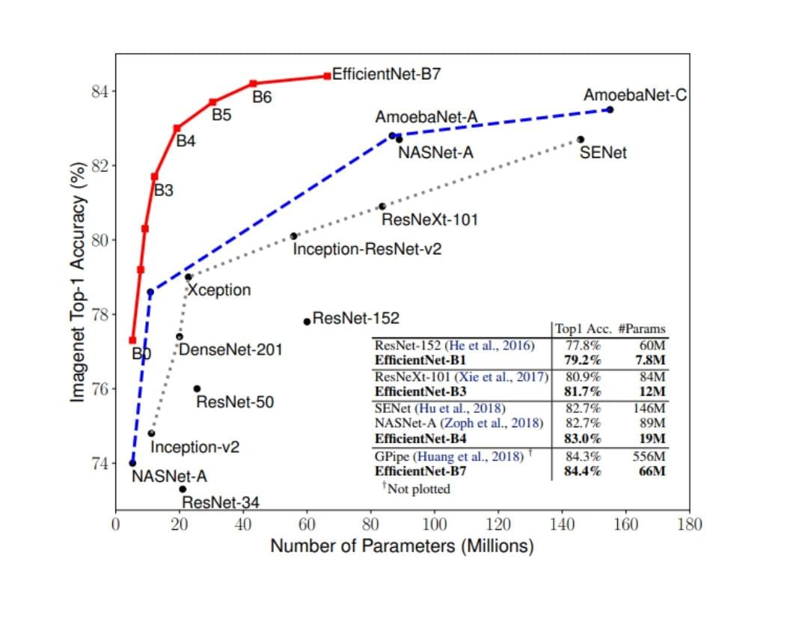
Efficient Net:
Efficient net adds a boost to normal CNN model upto 10-15% accuracy.
This is major improvement upto 6% while on the order of 5-10x more efficient than most current CNN’s.

Slide 8
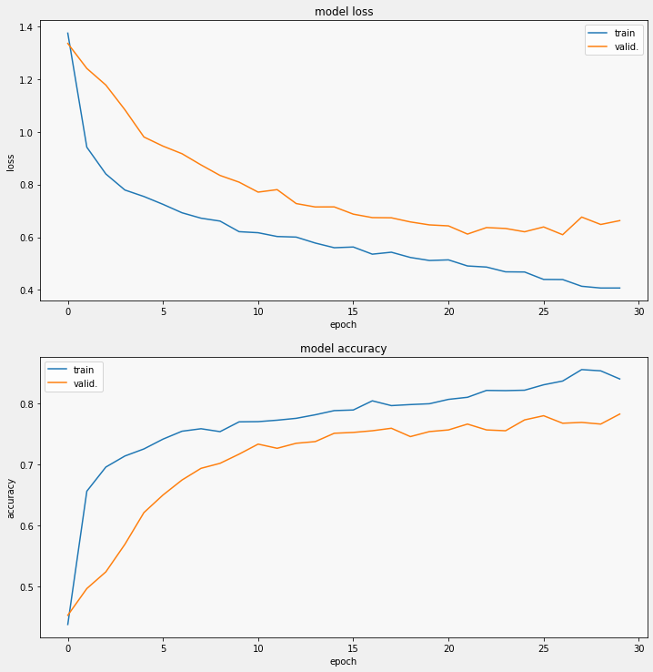

Slide 9


